Slide 1

The Nelson Mandela African Institution of Science and Technology
Course Name: Research Methods and
Communication
Course Code: 6001
(Lecturer: Elizabeth Mkoba, PhD)
Learning Unit 4: Sampling Techniques and Sample Size

Slide 2
Read This Slowly by Jakewoodard
“The Universe responds to your frequency. It does not recognize your personal desires, wants or needs. It only understands the frequency in which you are vibrating at.
For example,
If you are vibrating in the frequency of fear, guilt or shame, you are going to attract things of similar vibration to support that frequency.
If you are vibrating in the frequency of love, joy and abundance, you are going to attract things to support that frequency.
It is like tuning into a radio station. You have to be tuned into the radio station you want to listen to just like you have to be tuned into energy you want to manifest in your life”.

Slide 3
LEARNING OUTCOMES
Students should be able to:
Explain what sampling is.
Describe concept of sampling.
Describe sampling terminology.
Explain sampling techniques.
Explain probability sampling.
Explain non-probability sampling.
Describe sample size.

Slide 4
LEARNING UNIT 2 ASSESSMENT CRITERIA
Students should be able to:
Understood what sampling is.
Understood concept of sampling.
Understood sampling terminology.
Understood sampling techniques.
Understood probability sampling.
Understood non-probability sampling.
Understood sample size.

Slide 5
1. What is Sampling?
Sampling is the process of selecting a few (a sample) from a bigger group (the sampling population) to become the basis for estimating or predicting the prevalence of an unknown piece of information, situation or outcome regarding the bigger group.
A sample is a subgroup of the population you are interested in.

Slide 6
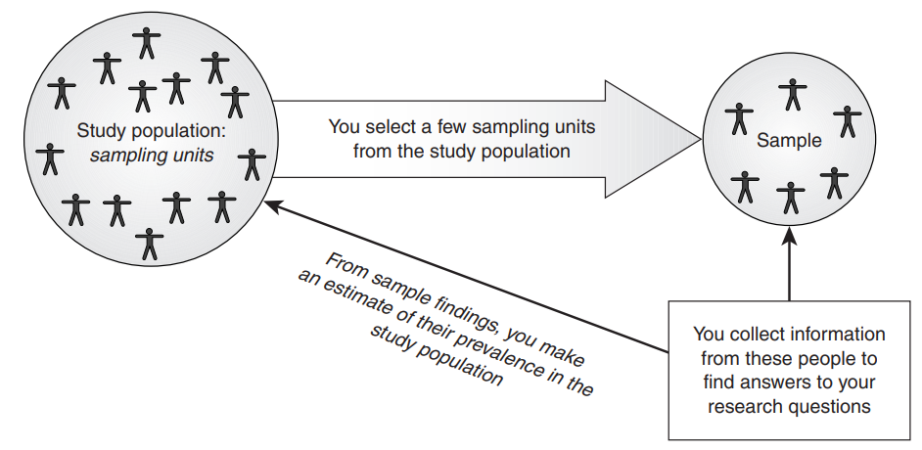
2. Concept of Sampling

Slide 7
2. Concept of Sampling …
Let us take a very simple example to explain the concept of sampling in quantitative research.
Example, suppose you want to estimate the average age of the
students in your class (Cohort 4).
There are two ways of doing this:

Slide 8
2. Concept of Sampling …
1. The first method is to contact all students in the class, find out their ages, add them up and then divide this by the number of students (the procedure for calculating an average).
2. The second method is to select a few students from the class, ask them their ages, add them up and then divide by the number of students you have asked.

Slide 9
2. Concept of Sampling …
This process of selecting a sample from the total population has advantages and disadvantages.
The advantages are that it saves time as well as financial and human resources.
However, the disadvantage is that you do not find out the information about the population’s characteristics of interest to you but only estimate or predict them. Hence, the possibility of an error in your estimation exists.

Slide 10
3. Sampling Terminology
Consider the examples to find out the average age of the class and the average income of the families living in the city.
The class, families living in the city from which you select your sample are called the population or study population, and are usually denoted by the letter N.
The small group of students, families from whom you collect the required information to estimate the average age of the class, average income is called the sample.

Slide 11
3. Sampling Terminology…
The number of students, families from whom you obtain the required information is called the sample size and is usually denoted by the letter n.
The way you select students, families is called the sampling design or sampling strategy.
Each student, family that becomes the basis for selecting your sample is called the sampling unit or sampling element.

Slide 12
3. Sampling Terminology …
A list identifying each student, family in the study population is called the sampling frame.
Your findings based on the information obtained from your respondents (sample) are called sample statistics.

Slide 13
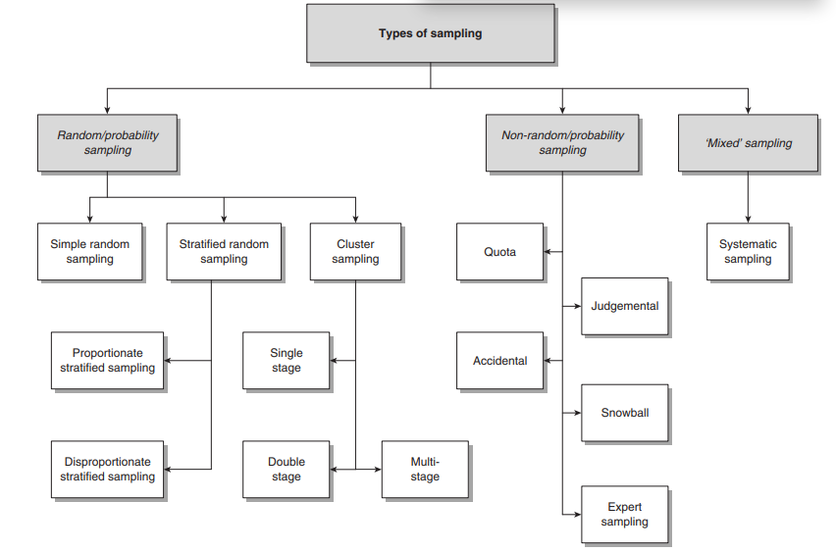
4. Types of Sampling (or Sampling Techniques)

Slide 14
5. Probability Sampling
Probability sampling is also known as ‘random sampling’ or ‘chance sampling’.
Under this sampling design, every item of the universe has an equal chance of inclusion in the sample.

Slide 15
Simple Random Sampling
Random sampling gives each individual, group or organisation an equal chance of being selected as an object/item of the study.
Random sampling every item of the universe/population has an equal chance of inclusion in the sample.
For example, names of 20 employees be selected from a total of 250 employees in a company. Means that the population is all 250 employees, and the sample is random because each employee has an equal chance of being chosen.

Slide 16
Stratified Random Sampling
Researcher divides population into separate groups called strata.
Stratification is a process of dividing members of population into homogeneous subgroups before sampling.
For example people living in Urban area, homogenous subgroups: government employees, students, private sector employees etc. Then select sample where members are selected from each subgroup.

Slide 17
Cluster Sampling
Cluster sampling is based on the ability of the researcher to divide the sampling population into groups (based upon visible or easily identifiable characteristics), called clusters, and then to select elements within each cluster.
Clusters can be formed on the basis of geographical proximity or a common characteristic that has a correlation with the main variable of the study.

Slide 18
6. Non-Probability Sampling
Non-probability sampling designs do not follow the theory of probability in the choice of elements from the sampling population.
Non-probability sampling designs are used when the number of elements in a population is either unknown or cannot be individually identified. In such situations the selection of elements is dependent upon other considerations.

Slide 19
Non-Probability Sampling …
There are five commonly used non-random designs, each based on a different consideration, which are commonly used in both qualitative and quantitative research. These are:
quota sampling;
accidental sampling;
judgmental sampling or purposive sampling;
expert sampling;
snowball sampling.

Slide 20
Quota Sampling
The main consideration directing quota sampling is the researcher’s ease of access to the sample population. In addition to convenience, you are guided by some visible characteristic, such as gender or race, of the study population that is of interest to you.
The sample is selected from a location convenient to you as a researcher, and whenever a person with this visible relevant characteristic is seen that person is asked to participate in the study.
The process continues until you have been able to contact the required number of respondents (quota).

Slide 21
Quota Sampling …
Example
Let us suppose that you want to select a sample of 20 male students in order to find out the average age of the male students in your class.
You decide to stand at the entrance to the classroom, as this is convenient, and whenever a male student enters the classroom, you ask his age. This process continues until you have asked 20 students their age.

Slide 22
Purposive Sampling
The primary consideration in purposive sampling is your judgement as to who can provide the best information to achieve the objectives of your study.
Researcher only go to those people who in your opinion are likely to have the required information and be willing to share it with you.

Slide 23
Snowball Sampling
Snowball sampling is the process of selecting a sample using networks.
To start with, a few individuals in a group or organisation are selected and the required information is collected from them. They are then asked to identify other people in the group or organisation, and the people selected by them become a part of the sample.
Information is collected from them, and then these people are asked to identify other members of the group and, in turn, those identified become the basis of further data collection. This process is continued until the required number or a saturation point has been reached, in terms of the information being sought.

Slide 24
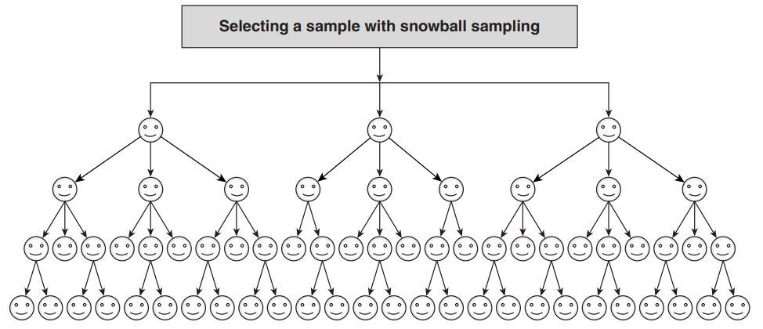
Snowball Sampling…

Slide 25
7. Sample Size
‘How big a sample should I select?’, ‘What should be my sample size?’ and ‘How many cases do I need?’
Basically, it depends on what you want to do with the findings and what type of relationships you want to establish.
Your purpose in undertaking research is the main determinant of the level of accuracy required in the results, and this level of accuracy is an important determinant of sample size.

Slide 26
7. Sample Size …
Sample size is the number of units that need to be surveyed in order for the findings to be precise and reliable.
The determination of the sample size differs depending on the research design
In order to provide the basis for a sound generalisation, the sample size should not be too small. As the sample size increases, the margin of errors decreases for a particular level of confidence.
Use statistical formula to calculate sample size or https://www.surveymonkey.com/mp/sample-size-calculator/

Slide 27

…End…

